Slide 1

High throughput NGS sequence data in-vitro, in color
Will Trimble
Argonne National Laboratory
Oct 8, 2013

Slide 2
What are thumbnails?
Illumina instruments record low-resolution images of the flowcell to assist the instrument operators in correcting problems. These are saved in the Thumbnail_images directory.
Scripts to generate false-color composites of entire flowcells are in http://github.com/wltrimbl/thumbnailpolish
Google search for “illlumina thumbnailpolish”

Slide 3
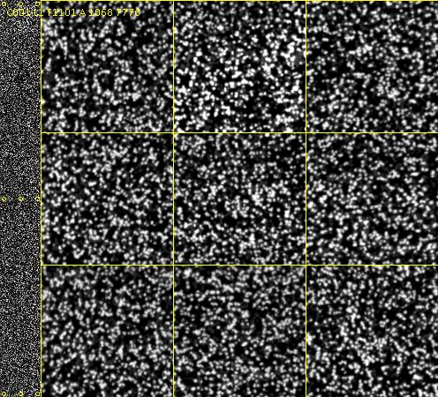
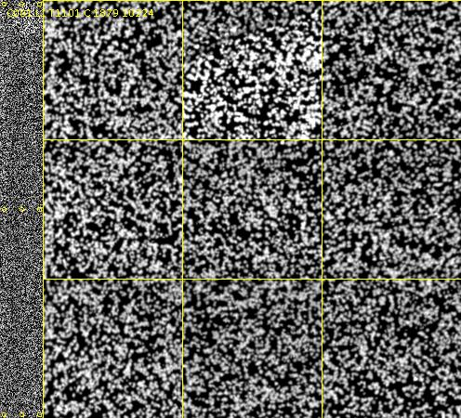
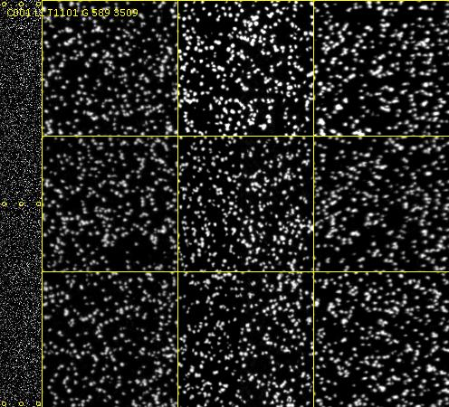
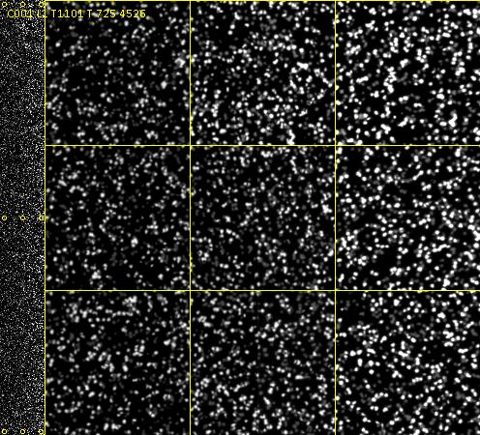
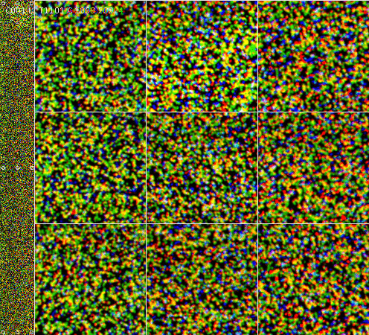
Color compositing
A image
C image
G image
T image
(These don’t correspond
to the actual colors of
the four organic dyes,
but what matters is that
the camera can adequately
distinguish all four.
Color
composite

Slide 4
Text
C001.1 T1101
cycle
and
tile number
Close-ups:
Nine boxes
with cluster-
resolved
images.
Wide shot
(image of
one tile)
on left
50 μm
4mm
750 μm
Note: this is not the actual data,
but a low-resolution visualization of it.
50 μm

Slide 5

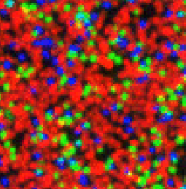
Shotgun: about a quarter of the
clusters are each of A, C, G, and T
for each cycle
Amplicon: because of sequence
conservation, most of these spots
are T in this cycle.
The clusters that are not red reflect
10% of the sequences that are shotgun.

Slide 6
Flowcell map of one lane
Tiles
1108 | 1107 | 1106 | 1105 | 1104 | 1103 | 1102 | 1101
1208 | 1207 | 1206 | 1205 | 1204 | 1203 | 1202 | 1201
1308 | 1307 | 1306 | 1305 | 1304 | 1303 | 1302 | 1301
2108 | 2107 | 2106 | 2105 | 2104 | 2103 | 2102 | 2101
2208 | 2207 | 2206 | 2205 | 2204 | 2203 | 2202 | 2201
2308 | 2307 | 2306 | 2305 | 2304 | 2303 | 2302 | 2301
top (?)
bottom
Tiling the tiles
Each lane has 48 or 96 “tiles” that are the units for image analysis; these have
four-digit names.
Stitching the images of the tiles together, we can get an image of the whole lane:

Slide 7
1108
1101
Lane 1
2308
2301
Lane 2
Lane 3
Lane 4
Lane 5
Lane 6
Lane 7
Lane 8
Hiseq flowcells have eight lanes, so these can be composited together to make an image
of an entire flowcell.
The Hiseq instruments can recognize about a billion spots in one data-acquisition session.

Slide 8
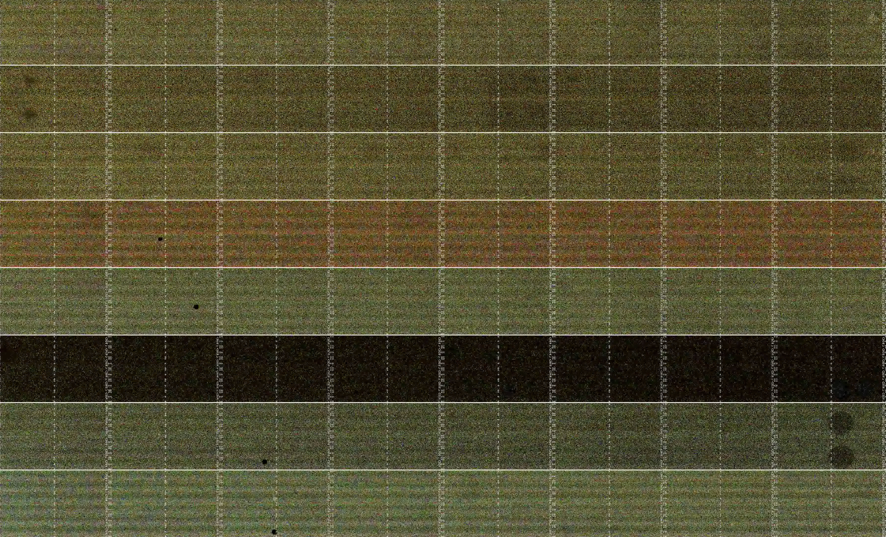
One flowcell (8 lanes):
A C G T
Greener lanes are GC rich
Pinker lanes are GC poor
Dark lane has low cluster density

Slide 9
Soft spots
There are spots on most flowcells that are dimmer than average.
Locally low cluster density or low cluster brightness.
Some of these persist for the entire run -> flowcell defects, bubbles in cbot reagents.
Some appear or disappear at the beginning of new reads: R1, index read, R2 -> bubbles in primer / polymerase buffer.

Slide 10
Soft spots
Persistent soft spot
End of R1:
Transient bubbles
Middle of index read:
New soft spot following R2 priming
persists for all of R2.
Beginning of R2:

Slide 11
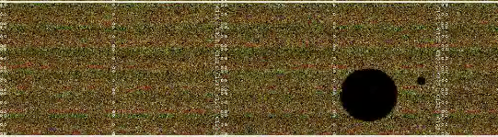
Dark bubbles
Many flowcell images have black circles. These look like flattened-out air bubbles.
These bubbles give rise to “N” basecalls.
These bubbles do not, however, keep the reagents from the clusters. These are bubbles
that were present when the camera was digitizing the images of the flowcell.
The chemistry happens when the camera is parked. The bubbles that could impede
the sequencing-by-synthesis reagents are flushed away before the camera arrives.
Inference: The clusters are there, and have the appropriate dyes, but they can’t be
photographed because of the bubbles in the imaging buffer. Consequently knowing the
positions of these bubbles doesn’t really tell you anything useful for sequence-analysis
jujitsu that you didn’t know by taking account of the Ns.

Slide 12
Dark bubbles
How much do these bubbles hurt me?
This bubble is about as large as a tile, so it causes 2% of the clusters on this
lane to have an “N” basecall on this cycle.
There are 200 cycles for this run, so this bubble made 10⁻⁴ of the basecalls on
the lane to be N’s.
Some tiles have higher error rates than others. (Cox et al. PMID 20875133)
This is one of the mechanisms for error-prone tiles.

Slide 13
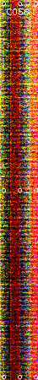
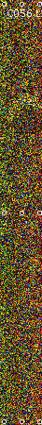
Striped tiles
When cluster yields are very low or when bubbles are present, stripe-shaped artifacts appear in the thumbnails.
Probably the result of color-correction in the camera going awry. Sometimes results in whole tiles being excluded from basecalling; this eats into yield but is otherwise not fatal.

Slide 14

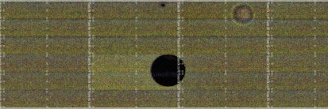
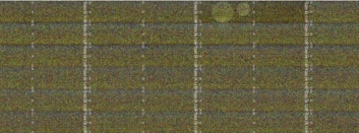
Top and bottom bubbles
Sometimes, bubbles upset the color balance in the rest of the tile:
Other times (on the lower surface?) bubble-shaped ghosts appear bright:

Slide 15
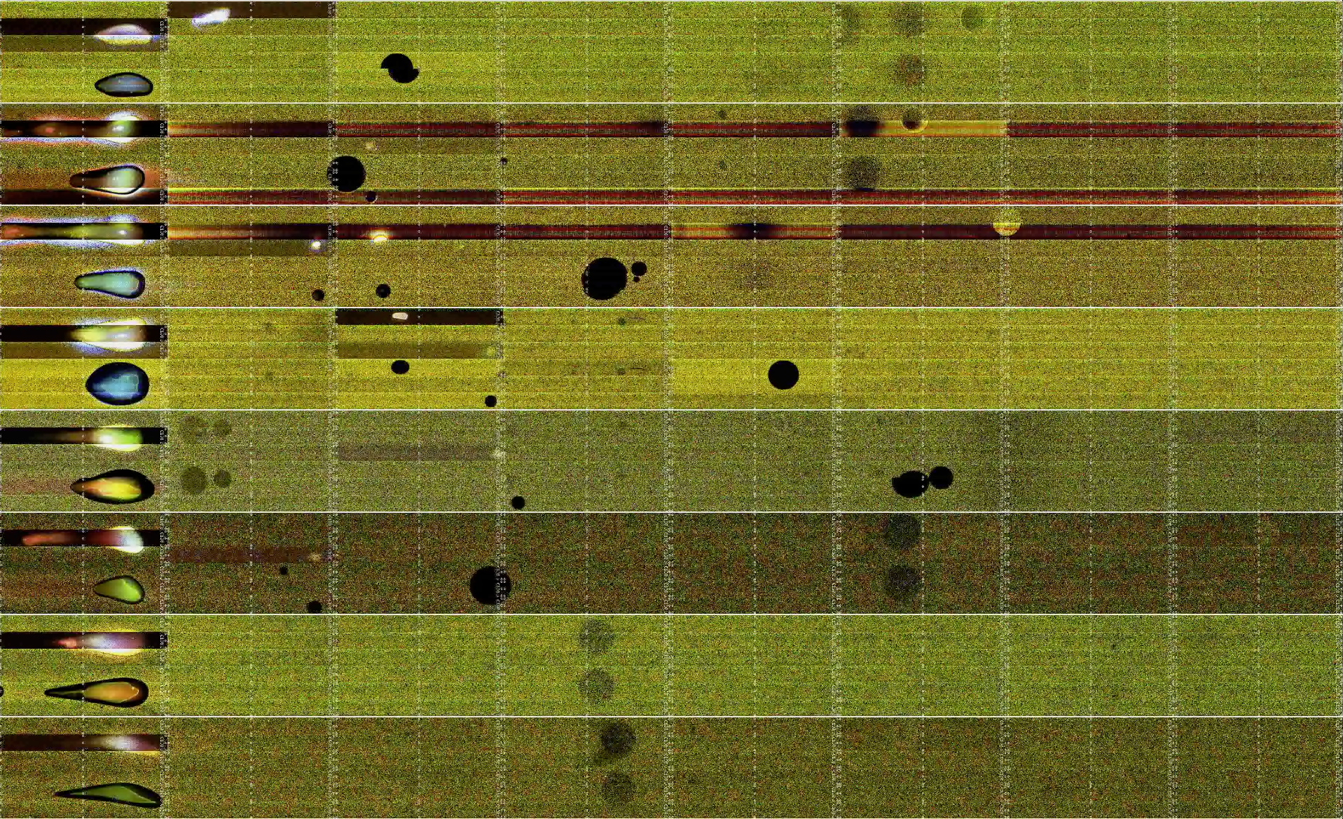
Sometimes the flow cell has a bad day.

Slide 16
Gallery
http://www.mcs.anl.gov/~trimble/nodi/hiseq-example.mp4 (contains the close-up of individual spots) http://www.mcs.anl.gov/~trimble/nodi/C1KU8ACXX.mp4 (entire cell) http://www.mcs.anl.gov/~trimble/nodi/130626_SN1035_0154_AC26L9ACXX-movie-lg.mp4 (more cells)
http://www.mcs.anl.gov/~trimble/nodi/sarah/Flowcellvideos.html The repository with the scripts to produce the movies is here: https://github.com/wltrimbl/thumbnailpolish

